Slide 1
In DIU Library, students can borrow books. Books have different properties like ID, name, author name, availability. Before borrowing a book, books availability is checked. Available books are issued. For an unavailable book no books are available is showed. Each student has Id and Name.
Question 1: Write down proper classes for the above scenario.
Question 2: Write a print method where student name and borrowed book ID will be shown.

Slide 2
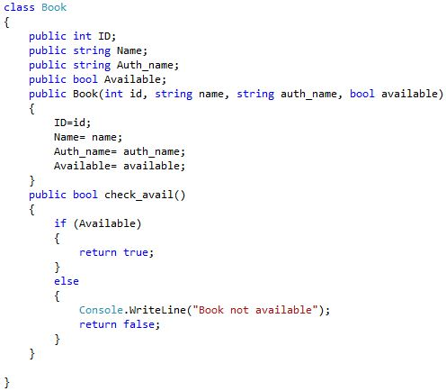
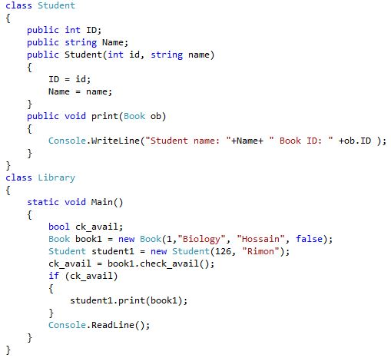

Slide 3
In United Hospital, a patient can visit a doctor. Each doctor can examine maximum 15 patients in a day. Staff has the ability to check if the doctor is available or not. If available then he can assign a patient to the available doctor.
Question 1: Write down proper classes for the above scenario.
Question 2: Write a program so that the staff can check if a doctor is available or not.
Question 3: If a patient assigned to a doctor then the staff can print the doctor name, doctor room no, and the staff ID who has assigned the patient.

Slide 4
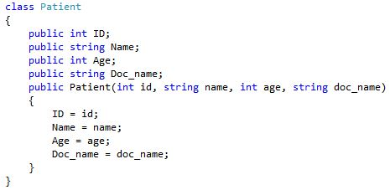
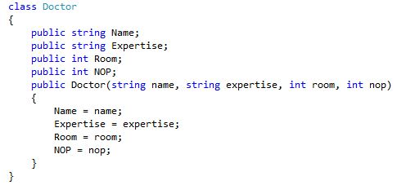

Slide 5
